Slide 1

Instructor Sir Muhammad Zunnurain Hussain
TA Sir Umair Makhdoom
MedStorePro Inventory Management System
Instructor Sir Muhammad Zunnurain Hussain
TA Sir Umair Makhdoom
Areeba Mahnoor BSSE23033
Zainab Faisal Bsse23045

Slide 2
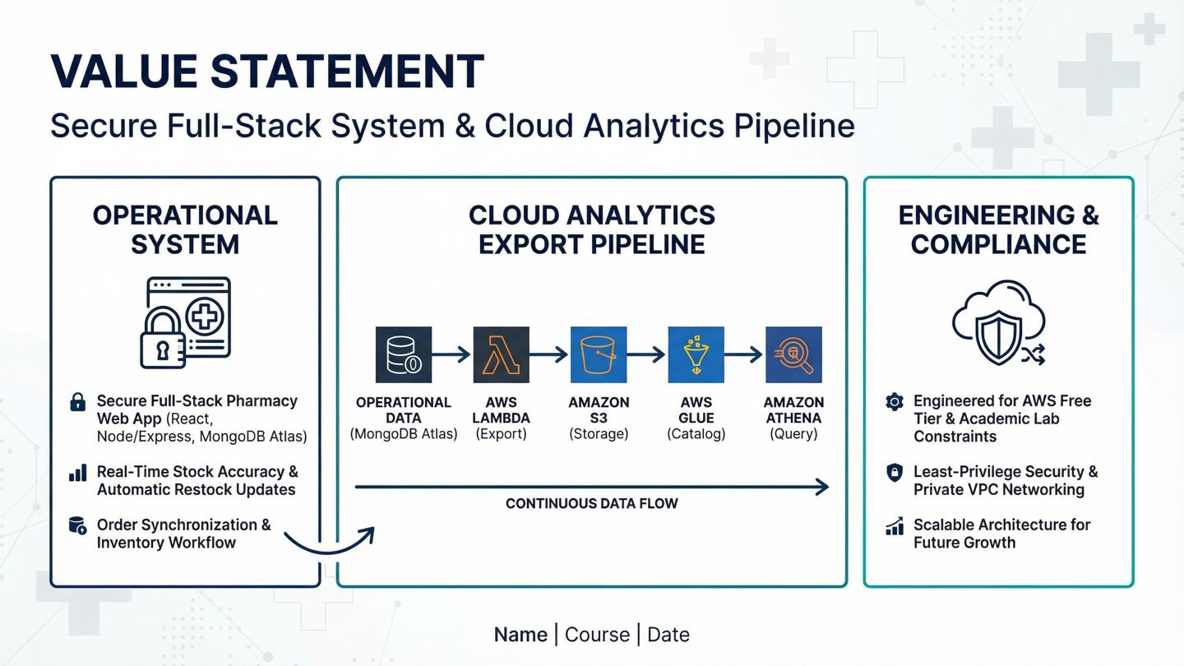

Slide 3
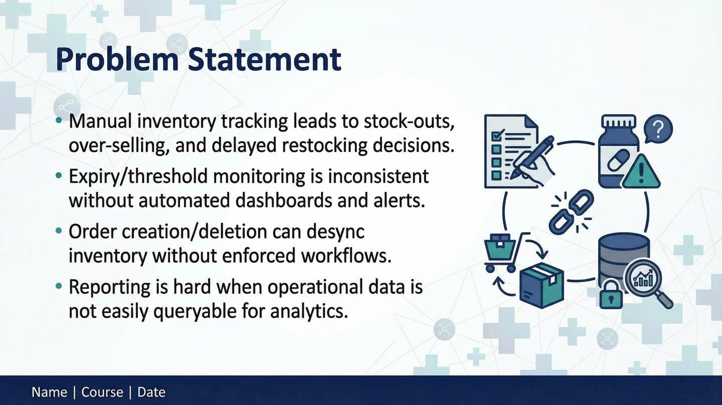


Slide 4
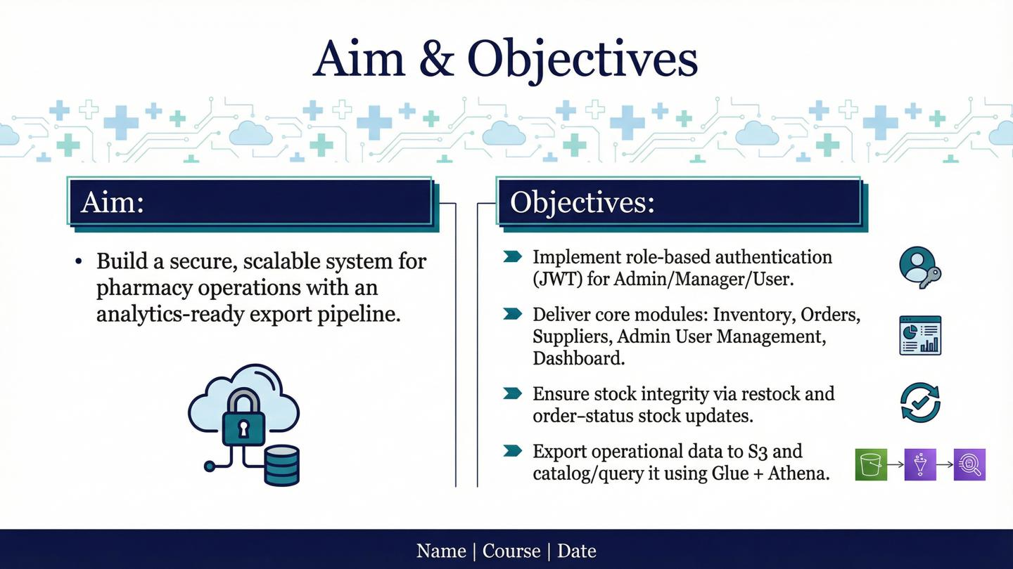

Slide 5
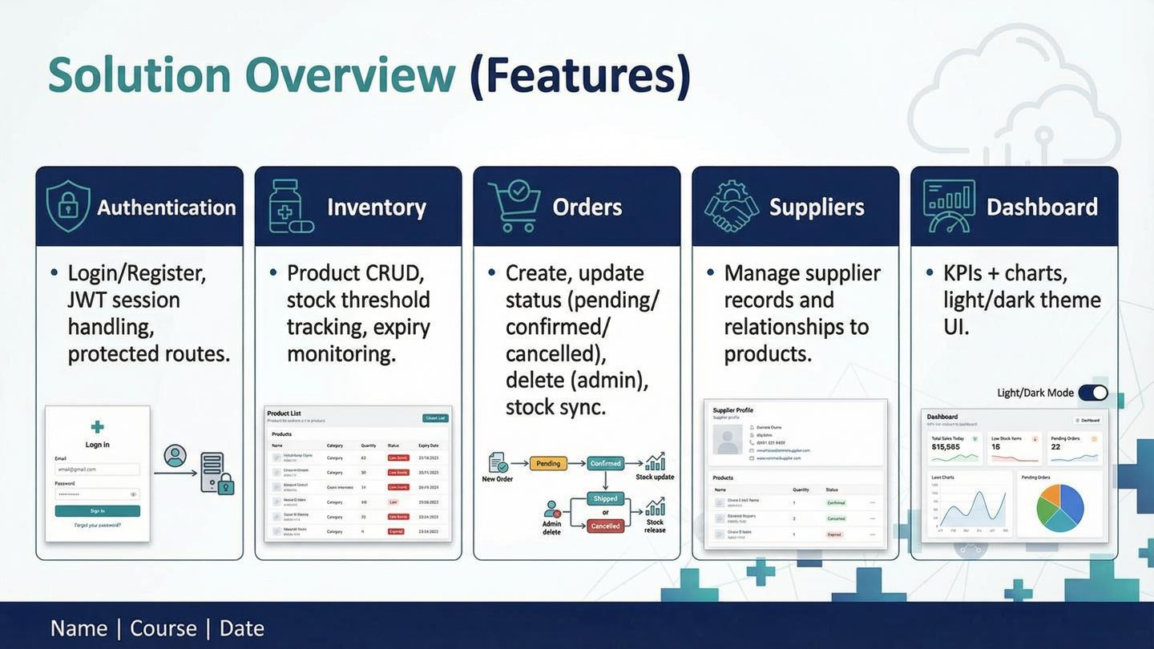

Slide 6
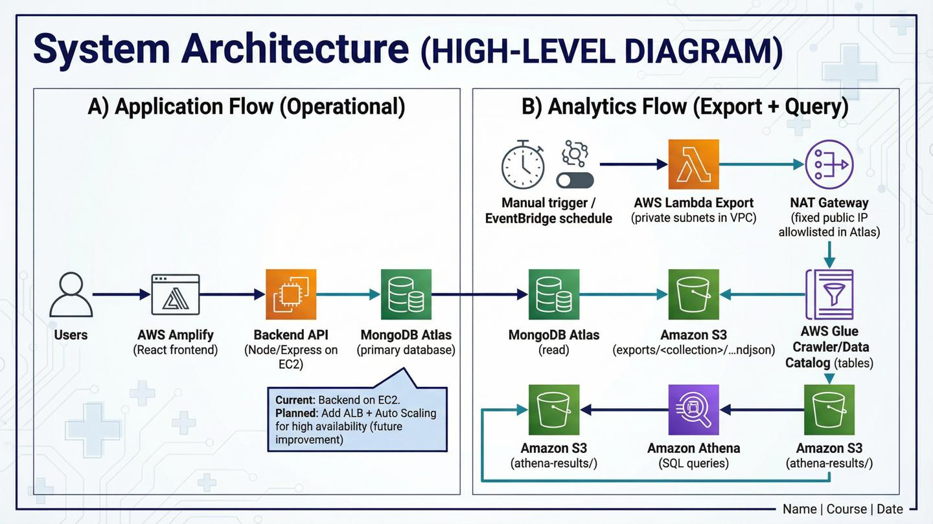
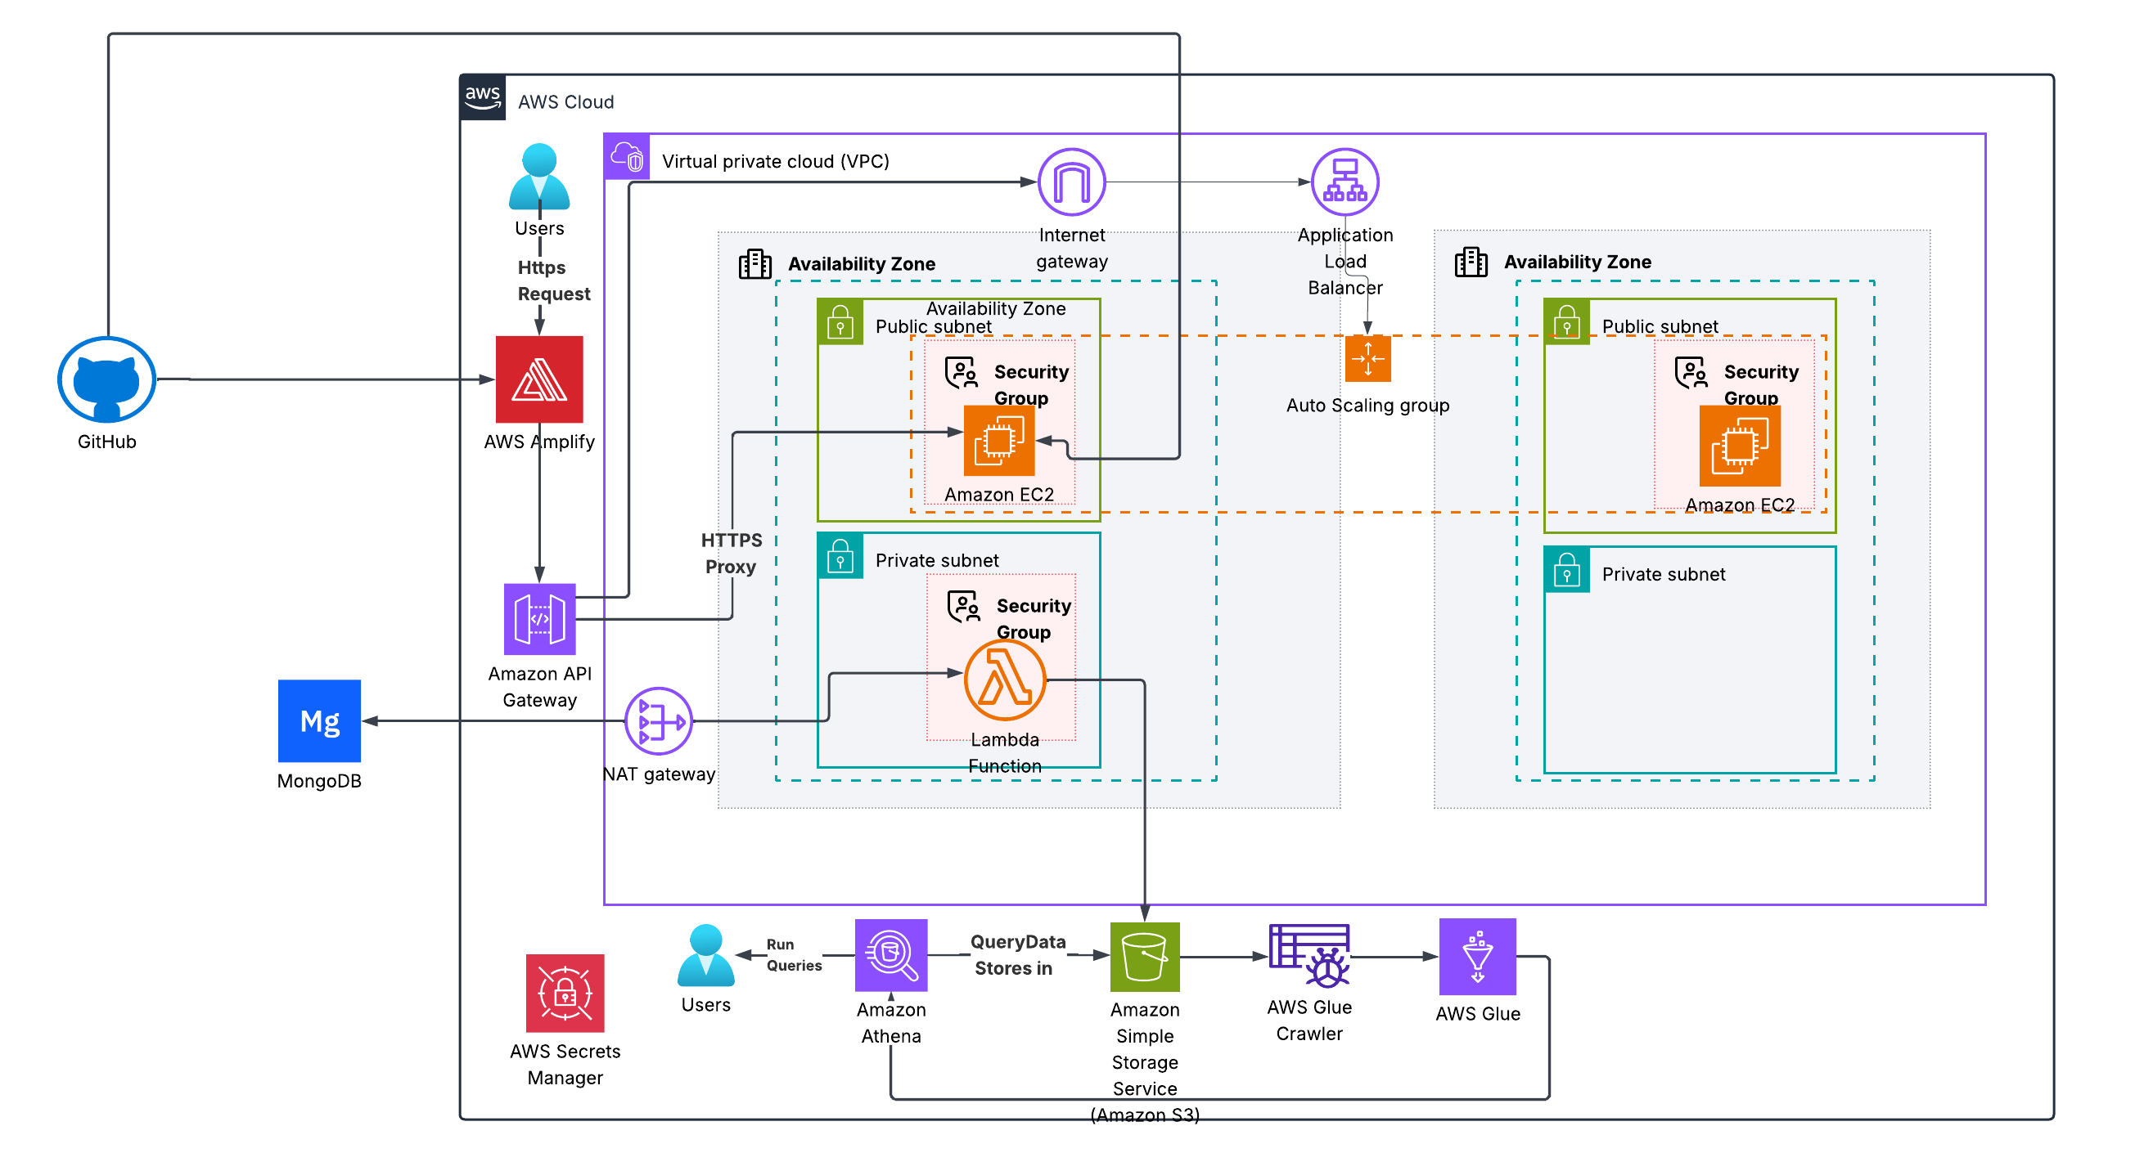

Slide 7
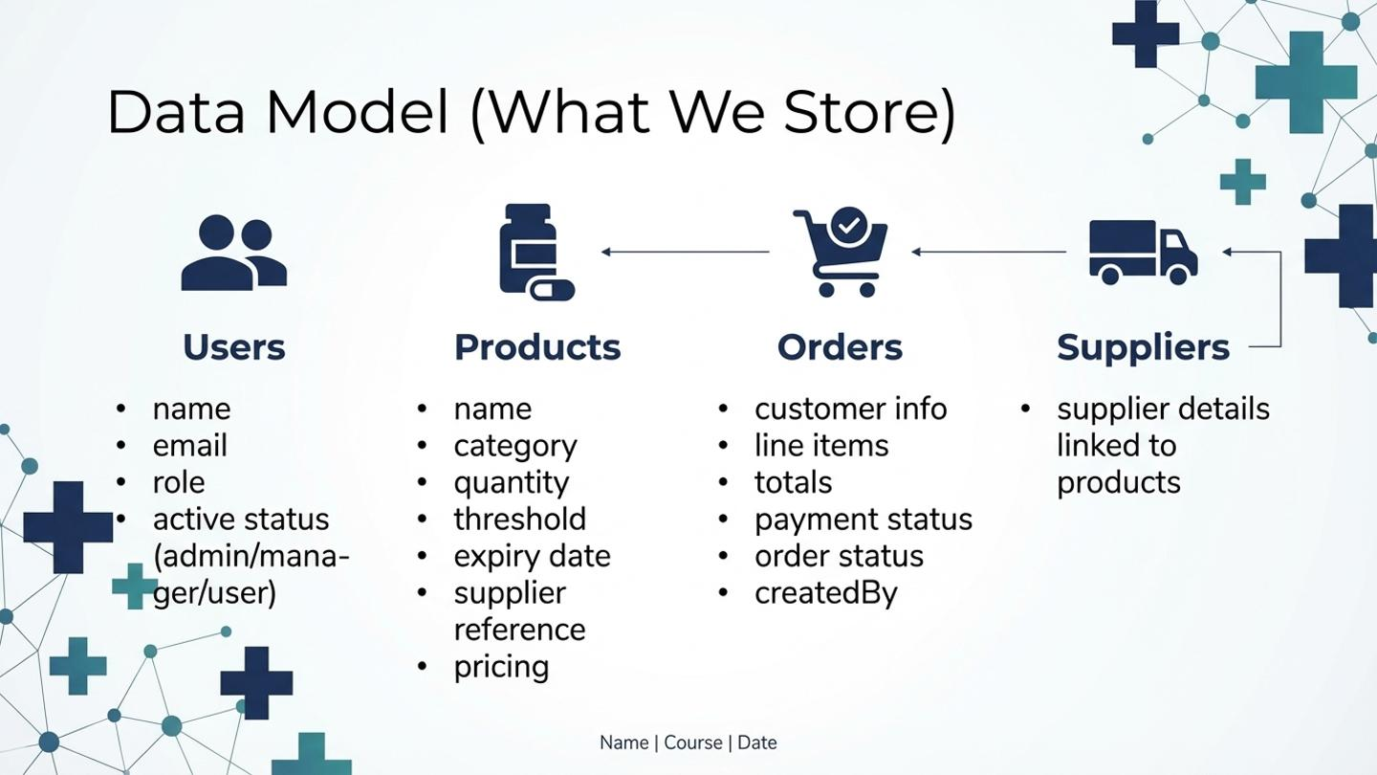

Slide 8
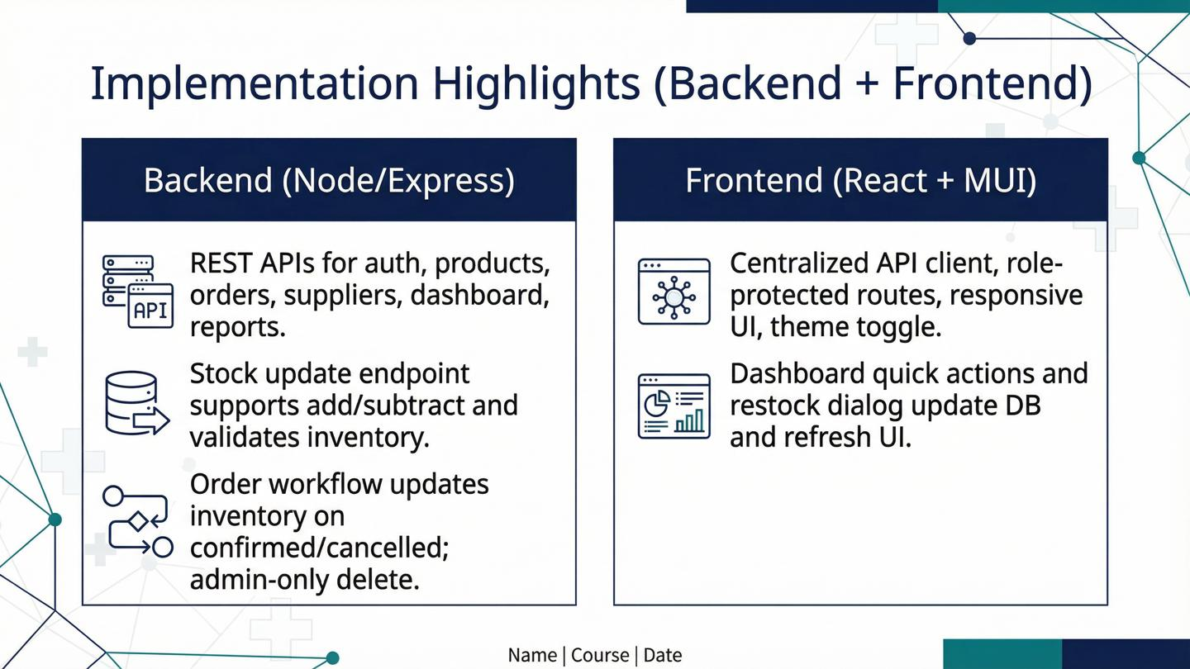

Slide 9
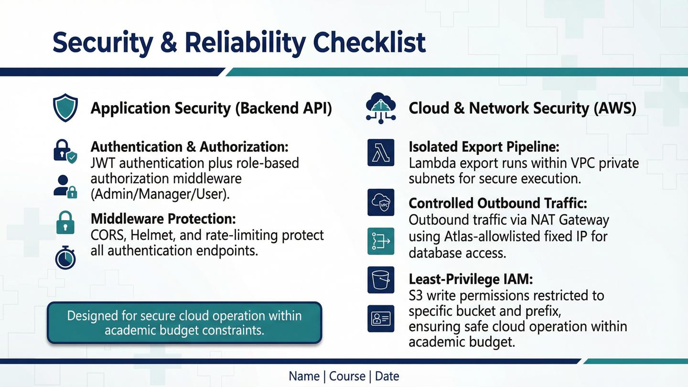

Slide 10
